Slide 1
Team Goomba
Chris B
Fanxing K
Zygomote
Ravikumar J
John Wayne H

Slide 2
Overview
Zygomote
Predispositions
Research
Insights
Concept
Strategies

Slide 3
Walking isn’t a habit
Notes:
Problem Space: Walking isn’t a habit
Problem Core: Getting people to walk for at least 20 minutes twice in two weeks.

Slide 4
20 – 30 year old Americans
Notes:
Target Audience:
20-30 year old Americans.
Why: Critical time in life, when individuals are able and possibly willing to establish lifelong good habits, including exercise regimens.

Slide 5
Zygomote
Notes:
Quickly Introduce Our Design: Zygomote (latin word we made up from zygo [to pair] and moto [movement])
A mobile application to encourage walking through three types of motivations:
social bonding
social accountability
small accomplishments

Slide 6
People have taken walks
Notes:
Predispositions:
People have taken walks with a reason
People are social
Good habits are hard to purposely form

Slide 7
People are social
Notes:
Predispositions:
People have taken walks with a reason
People are social
Good habits are hard to purposely form

Slide 8
Good habits are hard to form
Notes:
Predispositions:
People have taken walks with a reason
People are social
Good habits are hard to purposely form

Slide 9
People who walk often walk alone
Notes:
Primary Research:
Topic: Walking in general
(number of people, frequency of walk, duration, pleasing things, walking as a habit)
We conducted Interviews with 5 people, conducted ethnography studies, and we conducted auto-ethnography studies
Research Findings:
People who walk often walk alone
People who don’t walk often walk in groups and often they don’t think about the experience afterwards

Slide 10
People who don’t walk often walk in groups
Notes:
Primary Research:
Topic: Walking in general
(number of people, frequency of walk, duration, pleasing things, walking as a habit)
We conducted Interviews with 5 people, conducted ethnography studies, and we conducted auto-ethnography studies
Research Findings:
People who walk often walk alone
People who don’t walk often walk in groups and often they don’t think about the experience afterwards

Slide 11
Social motivations encourage physical activity
Chick Clique, CHI 2006
Notes:
Motivate people to exercise by tapping their social desire to be connected with their peers
Chick Clique, CHI 2006
Physical exercise habit: on the conceptualization and formation of habitual health behaviours, HEALTH EDUCATION RESEARCH, 1997
Use of persuasive technology for changing user’s behavior , which means technologies that are used in daily lives.
Mobile phone used in everyday lives.
Fogg, B.J. Persuasive Technology: Using Computers to Change What We Think and Do, Morgan Kaufmann Publishers, 2003.
Core Usages of Mobile Phones:
building and maintaining relationships
safety and security
personal information
organization
Mobile Phone Usage of Young Adults: The Impact of Motivational Factors, OZCHI 2008

Slide 12
Mobile technology can help change behavior
Mobile Phone Usage of Young Adults: The Impact of Motivational Factors, OZCHI 2008
Notes:
Motivate people to exercise by tapping their social desire to be connected with their peers
Chick Clique, CHI 2006
Physical exercise habit: on the conceptualization and formation of habitual health behaviours, HEALTH EDUCATION RESEARCH, 1997
Use of persuasive technology for changing user’s behavior , which means technologies that are used in daily lives.
Mobile phone used in everyday lives.
Fogg, B.J. Persuasive Technology: Using Computers to Change What We Think and Do, Morgan Kaufmann Publishers, 2003.
Core Usages of Mobile Phones:
building and maintaining relationships
safety and security
personal information
organization
Mobile Phone Usage of Young Adults: The Impact of Motivational Factors, OZCHI 2008

Slide 13
Habit Formation (5 stages)
American Heart Association, NIDDK
Notes:
Secondary Research:
Habit Formation and Long Term Change:
Pre-contemplation: learning; No convincing reasons to walk
Contemplation: try it once this week; start simple, pleasure in small victories
Preparation: try it once more next week; friends and family are important, goals
Action: once a week for 6 months; variety, lapses, positive mental attitude
Maintenance: once a week for more than 6 months; routine
American Heart Association
NIDDK (National Institute of Diabetes and Digestive and Kidney diseases)

Slide 14
Notes:
Starting is the first stage in habit formation.

Slide 15
Notes:
It is not difficult for people to recognize a need to change your behavior, but, they are likely to only do it once.
The contemplation stage of change is the time when people are thinking about change and trying to become more motivated to get started.

Slide 16
Notes:
Soon they will stop and never form a habit.

Slide 17
Notes:
When motivation is introduced, great things happen.

Slide 18
Notes:
With proper motivation, people will do the behavior again.

Slide 19
Notes:
As long as the motivation is there, people will do it regularly.

Slide 20
Notes:
When they do it again and again for 6 months, they have formed the habit.

Slide 21
Social bonding
Notes:
Insights:
Motivations that encourage walking:
social bonding
social accountability
small accomplishments
If we can show people how they are bonding, they will reflect and walk more

Slide 22
Social accountability
Notes:
Insights:
Motivations that encourage walking:
social bonding
social accountability
small accomplishments
If we can show people how they are bonding, they will reflect and walk more

Slide 23
Small accomplishments
Notes:
Insights:
Motivations that encourage walking:
social bonding
social accountability
small accomplishments
If we can show people how they are bonding, they will reflect and walk more

Slide 24
Reflecting on an experience can encourage walking
Notes:
Insights:
Motivations that encourage walking:
social bonding
social accountability
small accomplishments
If we can show people how they are bonding, they will reflect and walk more

Slide 30
Group Experience
Notes:
Design Space: Make walking enjoyable so it becomes a habit
Design Core: Walking in a group experience

Slide 31
Notes:
Concept Zygomote:
Story Overview
Open app 1st time
Start to walk
Earn newbie award
Walk with mike
Walk with boyfriend
View boyfriends overlay
Join a cause
Yoko and boyfriend’s clouds merge
Hearts animation and message
This is Yoko.

Slide 32
Notes:
She has a friend named Mike.

Slide 33
Check out Zygomote!
Notes:
Mike tells her about this walking application called Zygomote.

Slide 34
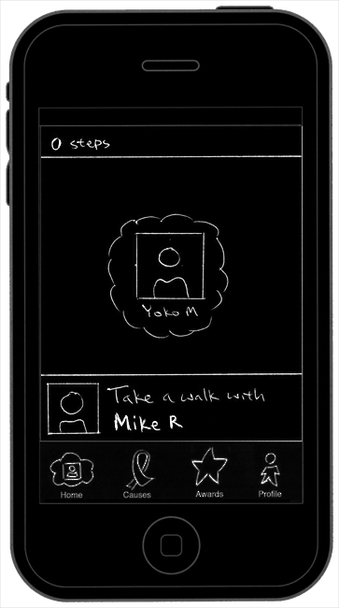
Notes:
Yoko downloads the application to her iPhone and logs in with her Facebook ID.
The application tells her that she should take a walk with Mike.
Design Rationale:
Our application, ZYGOMOTE, promotes walking through 3 motivational elements- social bonding, participation in community and
personal accomplishments. The components in the application - Home, Causes and Awards,
make use of the motivation elements - social bonding, community participation and personal accomplishments.
In addition, the application uses 'Profile' component to give more information about their walking activity.
We have icons for each of these components in the application icon bar at the bottom of the screen. This icon bar is
fixed and visible in all pages and at all times when the application is used so that user can
switch between the components easily. The icons are arranged in the order - Home, Causes, Awards and Profile
based on the balance between engagement and longer usage they are likely to achieve. "Home" is an engaging component
as it contains more visual information than textual information, while it allows to interact for a
longer time than the other components. "Causes" component deals with social accountability and
is likely to be used next to the "Home" component. "Awards" deals with personal accomplishment and likely
to be used minimally because of the time needed to earn each of the award. "Profile" component gives
information about the user, but we have "Quick Info" of the user available in the "Home" screen as
an alternative. Hence, when the user needs greater details about one's own walking, they can visit the
"Profile" component, at the end of icon bar.
Initially when the user downloads or gets this application, they have only their cloud avatar on the screen.
To encourage them to walk, ZYGOMOTE smartly recommends a person in their friends' list who also uses ZYGOMOTE application.
The recommendation is shown in the bottom of the screen but just above the icon bar. So once the user starts walking with the friends,
the application automatically senses the other person walking with the user and then starts working towards reflecting how it has
affected their bonding.

Slide 35
Notes:
Mike isn’t available for a walk, so Yoko decides to take a walk by herself.

Slide 36
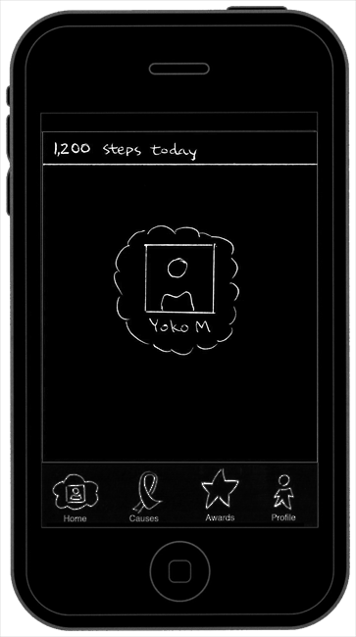
Notes:
Yoko opens the app during her walk and see’s her cloud avatar and her step count for today.
Home Screen Rationale:
In the Home component, the application uses clouds as metaphor to encourage social bonding for
representing users and their walking buddies. The cloud was chosen as the element for representation,
because cloud affords the ability to merge with one another, which gives the indication to the users that
gets closer with their buddies as they walk together and we found from our research that cloud is a
symbol for which users experiences after walking with others but necessarily have a reflection of it.
We chose "cumulus" type of clouds as they allow for spatial management on a mobile screen and are
pleasant to view compared to other type of clouds.
The users are shown in the application using cloud avatars. Cloud avatars have users' profile picture,
taken from their Facebook accounts, each in separate clouds. The user's cloud and other's clouds are spatially located based on
how much time they have spent together for a time frame. The time frame referred in the "Home" screen is indicated
at the top along with step count information. So for example if the current screen shows "10,000 steps this week" at the top ,
then the cloud avatars reflect the walking activity for that particular week and if the text at the top says "99,801 steps last month",
then the cloud avatars reflect the walking activity for last month.
The step counter of our user is visible at the top of the screen. The step count is shown for the current week or the last week
the user took a walk. We chose to have a weekly count because day/hour level basis count could be too little to motivate for a starter
and month/year level basis count could discourage after a point of time.

Slide 37
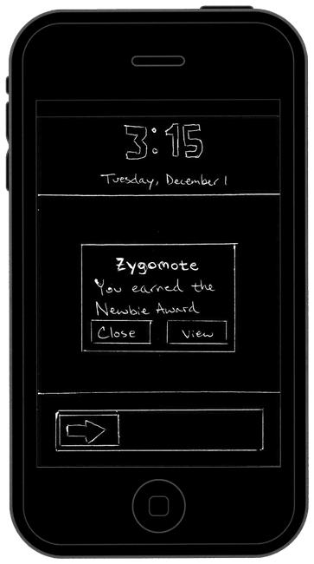
Notes:
Yoko puts her phone back in her pocket and continues to walk for about 10 more minutes. Then, her phone vibrates indicating that Yoko has a new message. She pulls out her iPhone and sees that she has earned the Newbie Award.
Awards Rationale: (see also Boy Scout Slide labeled “Awards” for more screen designs)
Deriving from Insights, small victories is a central motivator to establishing long-term behavioral change. Many video games use this same concept to encourage gamers to extend gameplay beyond the minimum requirements of the game. Valve's Orange Box games for the PC (which includes Half-Life 2, Portal, Team Fortress 2), for example, introduce dozens of Achievements, including Camera Shy (detach security cameras from the walls) and Terminal Velocity (fall 30,000 feet) (http://www.achieve360points.com/txt/t/The_Orange_Box_AG.txt).
By challenging users with Awards, we can show the user appreciation for walking under various circumstances and conditions. For instance, a Trenchfoot Award is achieved while walking in heavy rain; Firewalker for walking in the heat of a summer day; Sandman for walking along a beachfront; Newbie for starting to walk; and Ultramarathon after walking 100 miles. An Award is earned also for every Cause completed.
The Awards screen lists a continuous flow of available and earned Awards. Each Award features circular iconography with a title label. Clicking on one of these items will forward the user to a Detailed Award screen, showing more relevant information about that particular Award.
The iconography of the Awards yet to be earned are black-and-white and slightly transparent to indicate almost a "disabled" state. Any iconography not stylized this way are Awards already earned. Awards are ordered first by earned according to latest date; second by alphabetical yet-to-be earned.

Slide 38
Notes:
Later in the week Yoko takes a walk with Mike.

Slide 39
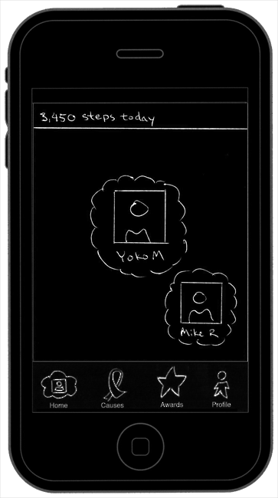
Notes:
Later in the week Yoko takes a walk with Mike.

Slide 40
Notes:
The next day Yoko asks her boyfriend Stephen to take a walk with her. She tells him about the application and he downloads it as well.

Slide 41
Notes:
The next day Yoko asks her boyfriend Stephen to take a walk with her. She tells him about the application and he downloads it as well.

Slide 42
Notes:
The next day Yoko asks her boyfriend Stephen to take a walk with her. She tells him about the application and he downloads it as well.

Slide 43
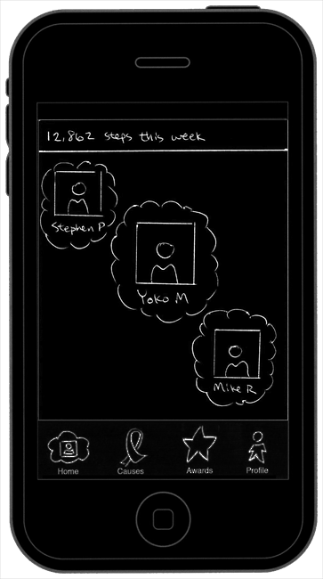
Notes:
The next week when Yoko is walking by herself, she decides to open the Zygomote application to view her step progress.

Slide 44
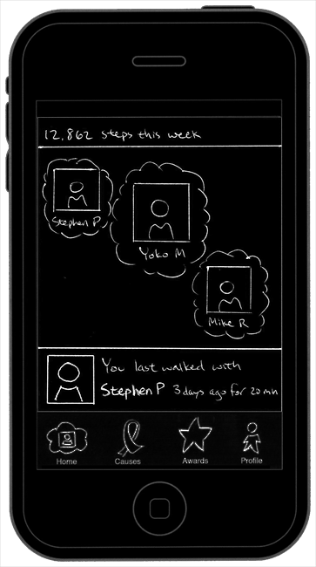
Notes:
She decides to click on Stephens’ cloud avatar to see some more information. She notices that she hasn’t walked with Stephen for the past 2 days.

Slide 45
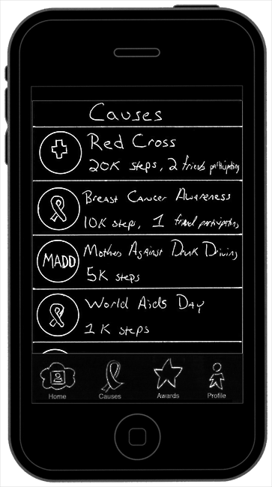
Notes:
Yoko decides that she wants to walk for a cause thinking that she might be able to get Stephen to join her as well.
She goes to the Causes screen and sees that one of the causes is Breast Cancer Awareness. Yoko thinks that this is a great cause to walk for and decides to click on it for more information.
Causes Rationale:
Causes session has a list of causes that users can walk for. On the list, each cause has its own logo and steps requirements. It also shows how many friends of the user's are walking for the particular cause.
When the user taps on one of the causes, a whole new screen will pop up, showing the cause's detail information such as requirements, description and the number of participants. The user's friends who are walking for the cause are listed under the cause's information. If the user tap on his/her friends there, the application will show the friend's profile. If the user wants to walk for the cause, he/she can tap on the JOIN button on the left side of the screen. If the user wants to go back to previous screen, he/she can tap on the CAUSES button in the top left corner. When they accomplish a cause, they will win a badge for the particular cause which will show up in the Awards session.
We initially believe that some people would like to walk for a reason such as a cause. Meanwhile, a cause provides a goal to the user. According to the research on habit formation we found, having a goal will help people go through a couple of stages to make a long-term change. Also, getting a badge when finishing a cause is an small accomplishment that encourages the user to walk more. We believe that showing the user's friends who are walking for the cause and the number of participants will remind he/she social bonding and social accountability which are also motivators for walking more.

Slide 46
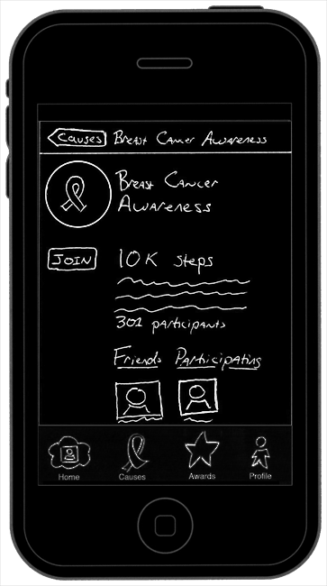
Notes:
Yoko sees that she could likely complete the requirements for this cause and decides to join it.

Slide 47
Notes:
Since Yoko and Stephen have both joined the Breast Cancer Awareness cause, they are walking a lot more.

Slide 48
Notes:
Since Yoko and Stephen have both joined the Breast Cancer Awareness cause, they are walking a lot more.

Slide 49
Notes:
Since Yoko and Stephen have both joined the Breast Cancer Awareness cause, they are walking a lot more.

Slide 50
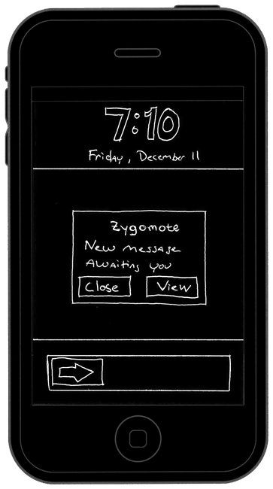
Notes:
While walking one day both Yoko’s and Stephen’s phone vibrate. Yoko pulls out her phone and sees she has a new message from Zygomote.
For rationale see Boy Scout Slide labeled “Awards” or slide #36

Slide 51
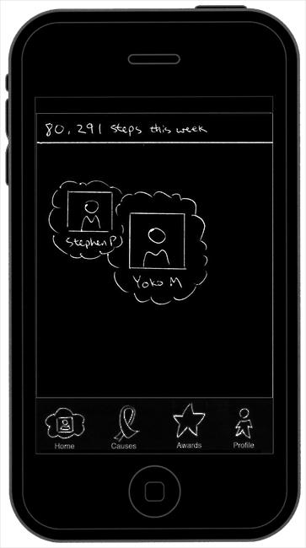
Notes:
Yoko clicks the ‘view’ button and is taken into the Zygomote application.
Yoko sees that Stephen and her clouds are merging because they have walked together so much!
Cloud Merge Design Rationale:
Since ten minutes they both started walking together, the application creates vibration and sends a message to them.
They take phones and open the message. The "Home" screen shows the animation of their clouds merging together.
A quote appears at the bottom of the screen, saying "Walking together promotes healthy relationships" which helps them feel
that walking has helped them get closer to each other. In addition, if both of them were in a relationship and this information
is available through Facebook, then the application detects it and adds beautiful hearts around the clouds and in the message bar
on the screen.
And if the user starts walking with a particular group of people or starts walking with different people, spending equal amount of time
walking with each of the group member, then they are grouped together automatically in a single cloud. The cloud carries a default
thumbnail representing a group of people, with names of 3 members under the picture in the cloud.
After few weeks, when the user opens the application and finds that one particular friend's cloud has moved away from their cloud.
When the user touches on the friend's profile, the information about the friend is shown at the bottom, telling the
how long has it been since the last time they walked and the duration of that walk. The user can then choose to walk the friend
to strengthen the relationship. In addition, the user could also tap on the quick information to find more. This would bring
them to the profile screen of the friend with additional details.

Slide 52
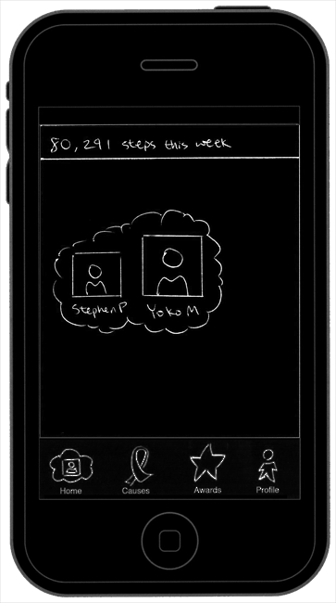
Notes:
Yoko sees that Stephen and her clouds are merging because they have walked together so much!

Slide 53
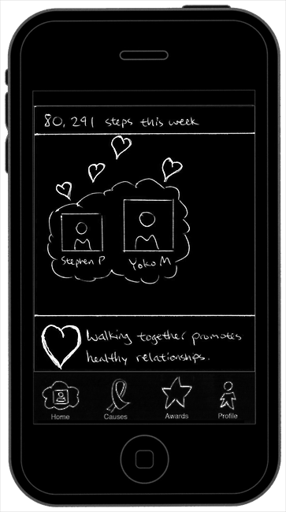
Notes:
Yoko sees that Stephen and her clouds are now merged and that hearts are coming out of it. She also notices the message at the bottom of the screen about how walking together promotes healthy relationships. This makes Yoko reflect on how much she has enjoyed walking with Stephen and vows to continue. They both continue their walk feeling very good about themselves and their relationship.

Slide 54
Activities as motivation to walk
Notes:
Strategies:
Activities as motivation to walk
Company sponsored walks (Nike, clothing company) to make this a free app
More application platforms

Slide 55
Application is Free
Notes:
Strategies:
Activities as motivation to walk
Company sponsored walks (Nike, clothing company) to make this a free app
More application platforms

Slide 56
More application platforms
Notes:
Strategies:
Activities as motivation to walk
Company sponsored walks (Nike, clothing company) to make this a free app
More application platforms

Slide 57
Thank You!

Slide 58
Summary
Cloud Avatars and Merging
reflection for group experiences
Causes
social accountability and long term motivation
Awards
Small accomplishments

Slide 59
Boy Scout Slides

Slide 60
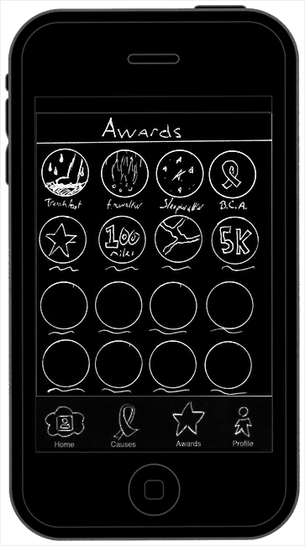
Awards
Notes:
Awards Rationale:
AWARDS
------
Deriving from Insights, small victories is a central motivator to establishing long-term behavioral change. Many video games use this same concept to encourage gamers to extend gameplay beyond the minimum requirements of the game. Valve's Orange Box games for the PC (which includes Half-Life 2, Portal, Team Fortress 2), for example, introduce dozens of Achievements, including Camera Shy (detach security cameras from the walls) and Terminal Velocity (fall 30,000 feet) (http://www.achieve360points.com/txt/t/The_Orange_Box_AG.txt).
By challenging users with Awards, we can show the user appreciation for walking under various circumstances and conditions. For instance, a Trenchfoot Award is achieved while walking in heavy rain; Firewalker for walking in the heat of a summer day; Sandman for walking along a beachfront; Newbie for starting to walk; and Ultramarathon after walking 100 miles. An Award is earned also for every Cause completed.
The Awards screen lists a continuous flow of available and earned Awards. Each Award features circular iconography with a title label. Clicking on one of these items will forward the user to a Detailed Award screen, showing more relevant information about that particular Award.
The iconography of the Awards yet to be earned are black-and-white and slightly transparent to indicate almost a "disabled" state. Any iconography not stylized this way are Awards already earned. Awards are ordered first by earned according to latest date; second by alphabetical yet-to-be earned.
AWARD DETAILS
-------------
The Award Detail screen lists detailed information about a particular Award, including large iconography, title, requirements to achieve the Award, and a list of all friends who have already earned the Award. If the user has earned the Award already, it also mentions when it was last earned.
A Cause Award can be earned multiple times, and a counter label will appear in the top right corner of the iconography after earned at least twice. There's no need to show this label when earned once, since the iconography will turn into color and fully opaque after earning an Award once.

Slide 61
Profile
Notes:
Profile Rationale:
The Profile screen lists general, statistical information concerning the user's interaction with the application. The first section displays the user's full name; when the individual last walked; and the user's Facebook profile image. These items are essentially reiterations of the content visible when clicking on Avatar Clouds on the Home section. These are the most essential elements describing a person's profile.
Walking Summary is the next section, describing an individual's total steps, duration, and distance walking since initiating the application. Such statistics would not be accessed frequently, so they're only displayed in this screen.
Current Cause follows afterward, visible only if the user is participating in a Cause. Since a user can only participate in one Cause at a time, this will only display one item. A list of all past Causes participated is not relevant, since such information would be accessible under an Award list.
Similar to Current Cause, the next section would display the user's Latest Award. A button advancing to an Award list could be added, but is not essential for this iteration.
The last section is Top Friends, listing the three individuals the user walks with the most over all time. The last item in the list is a button labeled "More," which when clicked will push the next top three friends at the end of the list.

Slide 62
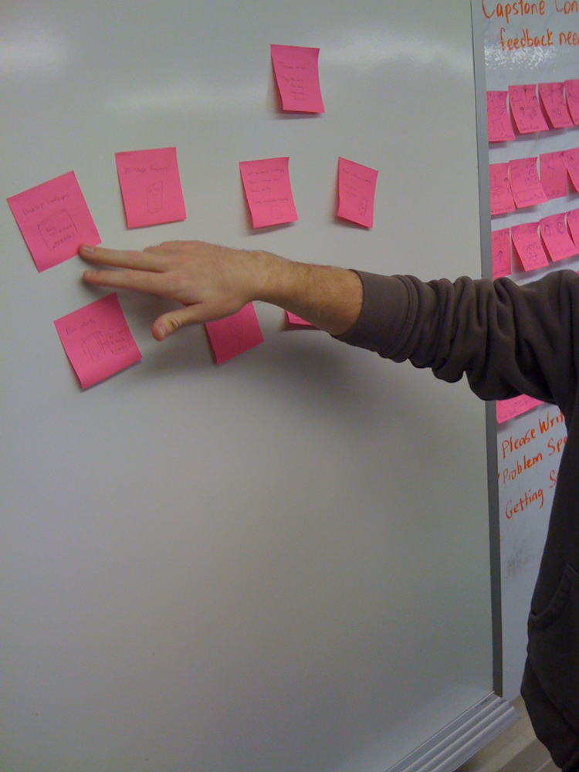
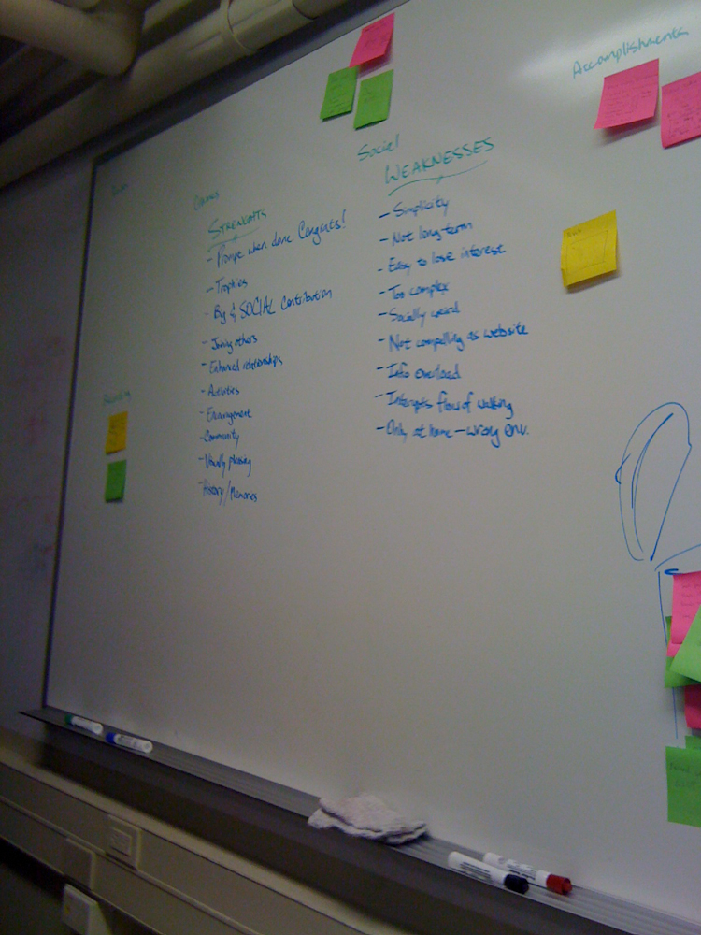
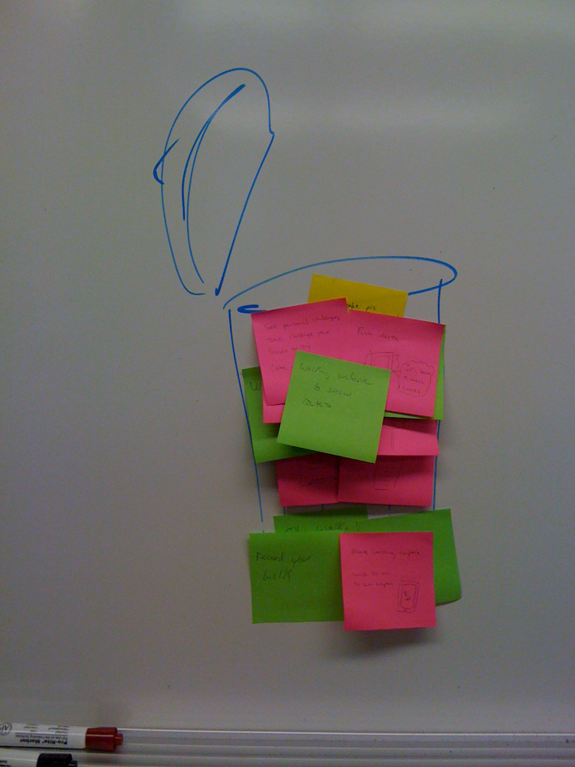
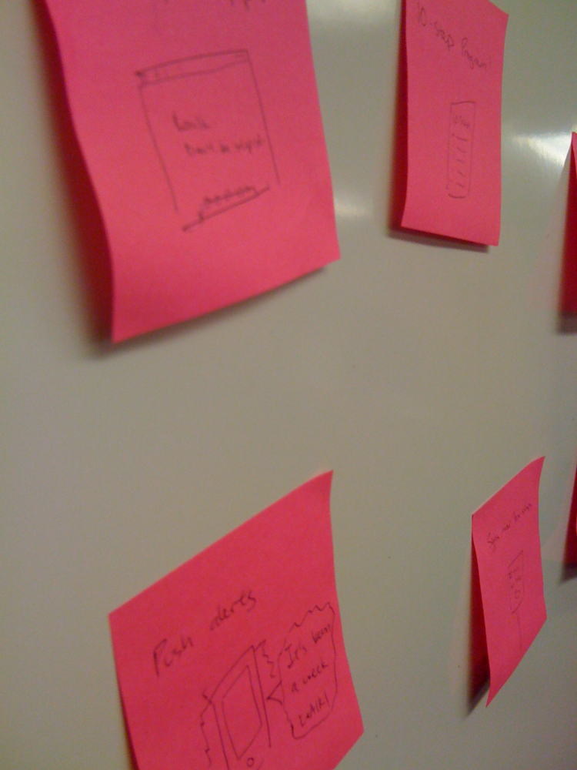
Lenses Exercise
Notes:
Lenses Exercises:
We completed the following exercises:
Freely ideate new approaches.
Organize the current information and new ideas.
Negate.
Strengthen the solution
Prototype
While doing this we found some especially interesting things about our ideas, both new and old.
Specifically we found the strengths and weaknesses to be of great use while moving forward.
Strengths
Prompts when done. Congrats!
Trophies
Big and Social contribution
Joining others
Enhanced Relationships
Activities
Encouragement
Community
Visually pleasing
History/memories
Weaknesses
Simplicity
Not long term
Easy to lose interest
Too complex
Socially weird
Not compelling as a website
Information overload
Interrupts the flow of walking
Only at home – wrong environment

Slide 63
Usability Study
We conducted a usability study with three participants at the Wells Library.
Our script is included in the speaker’s notes below.
Notes:
Usability Study, IDP Project 5
Introduction
Hello, my name is ____________________. I'm here with some classmates to test an iPhone application. We are here to test the design of the application and not you. We would like to get your feedback and opinions on this design.
Do you have experience using an iPhone, iPod Touch or similiar touch screen technologies?
(If yes) Please keep in mind the large range of gestures that iPhone applications use.
(If no) Ask if they have any experience at all, if they do, explain the iPhone gestures. If not, Kindly thank the person for thier time.
Also, we would like to video record your participation today so that we don't have to feverisly scribble notes and so that we don't miss out on anything. Your information will be kept confidential. Is it ok for us to video record?
We ask that while you are using this application that you talk aloud about what you are thinking and feeling (give an example). Also, it is important for you to use this paper design as you would a real iPhone applicatoin, that is to say please touch the paper as you would the touch screen on the iPhone or other devices.
Now, I'd like to read you what's called a statement of informed consent. It's a standard thing I read to everyone I interview. It sets out your rights as a person who is participating in this kind of research.
As a participant in this research:
You may stop at any time.
You may ask questions at any time.
You may leave at any time.
There is no deception involved.
Your answers are kept confidential.
Any questions about all that?
Ok, let's start.
Scenario Assume you are "Yoko". Your friend, Jason talks about the application "appp", which shows your status of walking with people. The application uses clouds as a metaphor. And, as you are walking with them, your cloud and your friends' cloud(s) will start getting closer and eventually merge. You download and open this application. Home Screen Tasks You see the home screen and you want to explore it.
Are you able to find yourselves in the screen?
Where do you find your current no. of steps? {Is it cumulative}
How many friends do you currently see in this view?
What else do you see in this view?
How would you view your walking activity over a longer time period?
How do you return back to the previous screen?
How do you merge your cloud with Jason's?
How do you separate your cloud from his?
How can you find quick information about your walking?
How would you find more information from there ?
How do you back to the previous screen?
How can you find quick information about your walking buddies?
Activities Tasks You want to do some activity when you are walking with your friend.
How do you go to "Activities" screen?
You want to get more information on the "Museum" activity. How would you do it?
How would you go back to the "Activities" screen?
Casuses Tasks You want to walk for a social cause.
How do you go to "Causes" screen?
You want to get more information on the "Red Cross" cause. How would you do it?
How would you join the "Red Cross" cause?
Badges Tasks You have walked for a while with your friends and you've got a badge.
How do you go to "Badges" screen?
You want to get more information about the "Trench Foot" badge on your screen. How would you do it?
Overview Tasks You want to see overview of how you have walked.
How do you go to "Overview" screen?
Debrief
We would like to thank you for your participation and ask you a few questions in closing.
Post-test questionnaire
What is your overall impression of the app?
What's your interpretation of clouds and the space between them?
What do you think about the time information at the bottom of the screen?
Do you find the icons correlating with the functionality? {needs rewording}
How would you rate the easiness of the application (1-7), 1 being the least useful?
What are the benefits you see when you use it?
How do you feel it is going to connect with friends?
Would you be happy if you use it with your friends?
Will you use it?
What features would you suggest that should be included in this application, so that you would walk with your friends?
Do you have any other comments for improvement of the app?
Closing
On behalf of this project we would like to thank you for your participation. If you would like more information please feel free to contact me at _________________________.

Slide 64
Usability Study: Results
Some basic notes are attached here as speaker’s notes. A results table is included with the printout at the bottom of the Usability Study.
Notes:
User 1:
User 2:
- Doesn't know what "14% Red Cross" means.
- Doesn't know the Cloud visualization is in the Home screen.
- "Red Cross" is understandable only after it was labeled as a Cause.
- Top Friends are those you walk with the most.
- The closer the friend is in the Cloud visualization to the user's avatar, the more they walk together.
- Thinks merging clouds would cause Cause percentages to increase.
- Not sure what Activities are until after viewing the screen.
- Don't know if the label "2 friends" means two friends are allowed to attend an Activity or two friends are currently participating.
- This application is better suited for older demographics.
- Would only walk for monetary incentives.
User 3:-
- Concerned about many cloud avatars overcrowding screen, leading to confusion.
- Does "last walked" mean the last time a friend walked or the last time a friend walked with you?
- Does not know how to change the time range on the Cloud visualization. Navigates to Overview screen but notices nothing that may help. Gives up trying task.
- Merging clouds means you're walking with that person a lot.
- Friend lists in Activities are those individuals you have walked with in the past to a certain activity.
- Activities are things you've done. Does not think they are things you can do.
- Navigates to Badges to join a Cause.
- This application should be priced free. It's not compelling enough to purchase.
- Wants to know how much you've walked.
- This application would encourage the user to walk more.
- Activities is the strongest motivator.

